Slide 1
NUC126 MSD ISP
Notes:
115/11/07

Slide 2
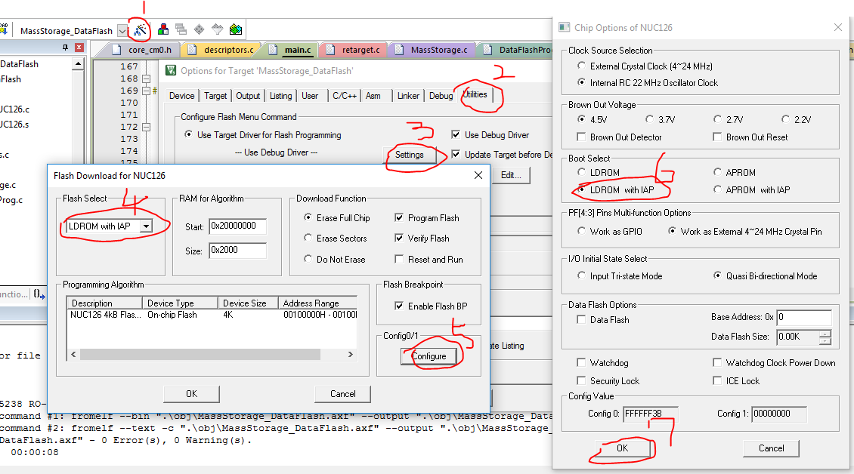
CONFIG SETTING(LDROM WITH IAP)

Slide 3
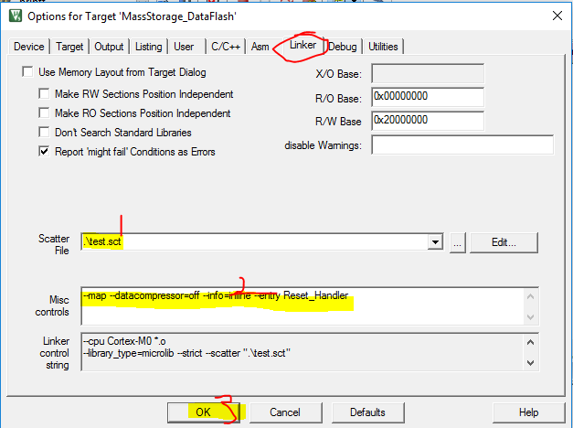
PROJECT Scatter File

Slide 4
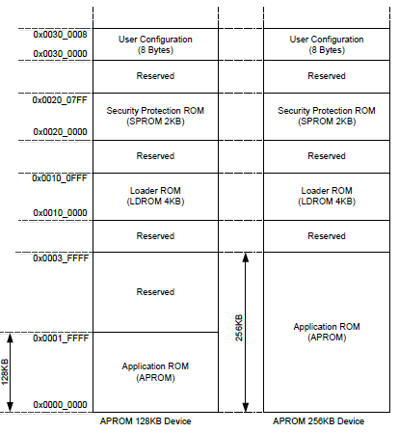
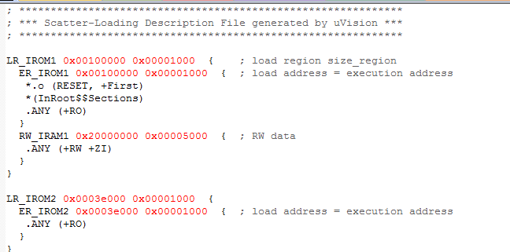
Test.sct
0x3e00
LDROM code share APROM flash

Slide 5
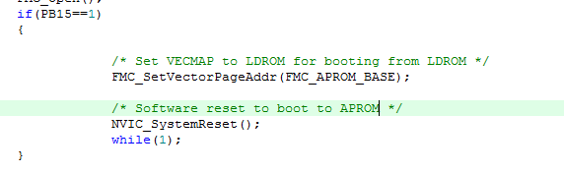
LDROM or APROM select
Power on, MCU boot in LDROM WITH IAP
  PB15==1 jumper to APROM
  PB15==0 keep in LROM

Slide 6
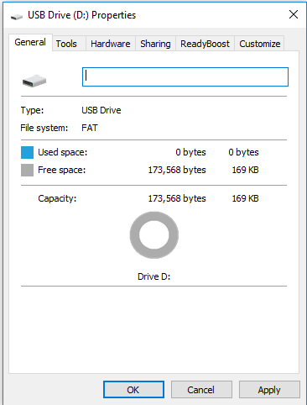
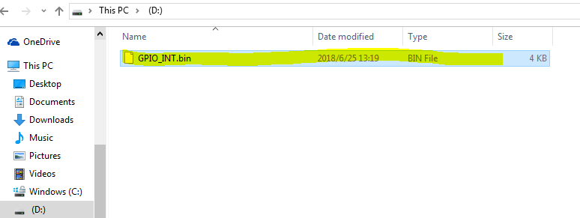
MSD ISP
Drop bin file to the disk
And updated APROM.

